Slide 1
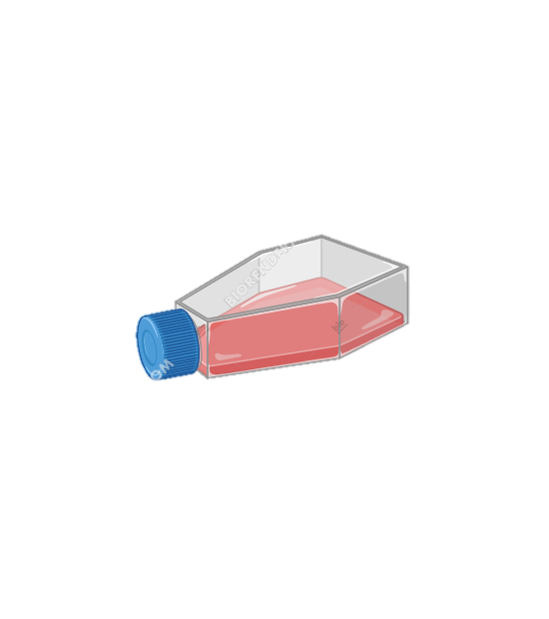
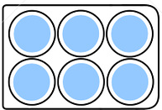
Split cells to 1xT-25
Split cells to 1xT-150
Split cells to 3x6-well plate
Transduction
Differentiated ARPE-19
MOI – 100-200K
Time point – 6 hpt
Cell lysis
Fenretinide
3 uM
CC
1/1
1/2
1/3
20/05
23/05
25/05
30/05
31/05
5 days
2/1
2/2
2/3
AAV-GFP
ARPE-19
T-150
ARPE-19
T-25
3 days
3 days
AIPL-1
3/1
3/2
3/3
4/1
4/2
4/3
AIPL-2
AIPL-3
5/1
5/2
5/3
AIPL-4
6/1
6/2
6/3
NGS sequencing
duplicates
qPCR

Slide 2
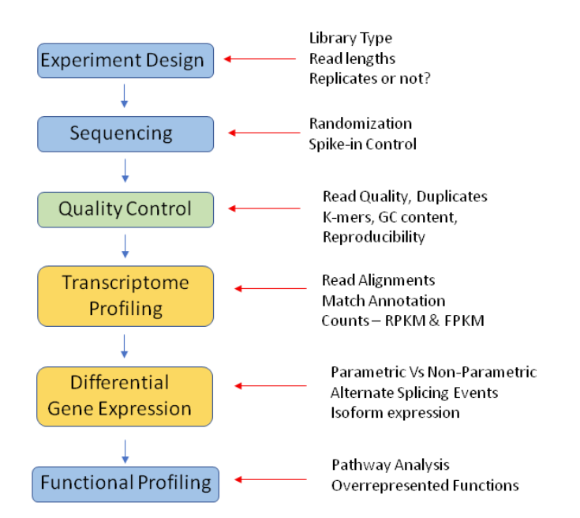
RNA-seq pipeline

Slide 3
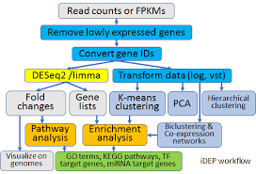
RNA-seq pipeline

Slide 4
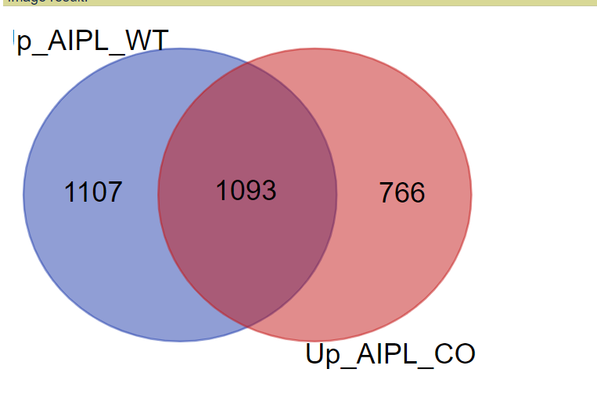
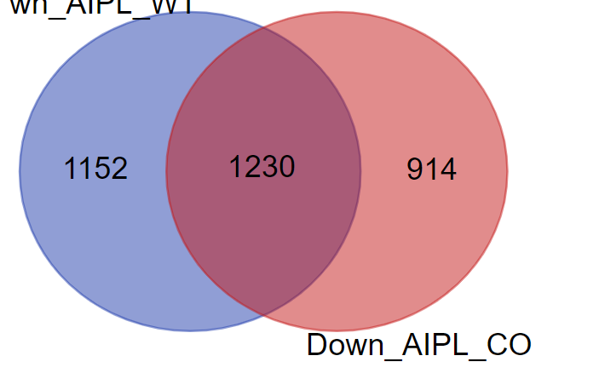
UPgulated
DOWNregulated

Slide 5
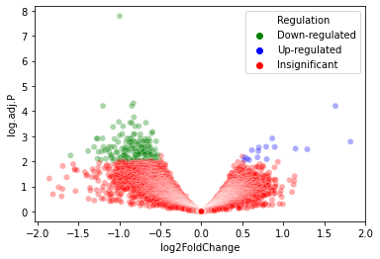
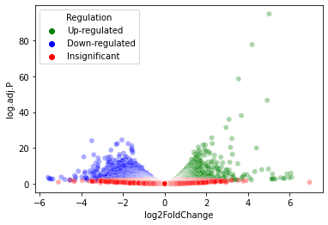
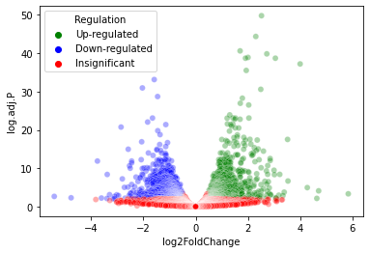
CC-GFP
AIPL-1-3
AIPL-1-6

Slide 6
Gene Ontology and annotation

